Slide 1










Shift Registers and Memories
LAURINE OWINO (LAMOY)

Slide 2
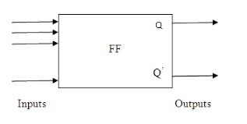
Flip-Flops
Basic memory elements capable of storing one bit in a digital system.
Types:
D flip-flop
R-s flip-flop
J-K flip-flop
T flip-flop

Slide 3





Digital device for data storage and and transfer - data is entered then shifted out
Shift Registers
Links between main digital system and I/O channels
Constructed by flip-flops. Number of flip-flops defines the size of the register

Slide 4
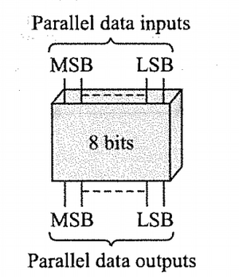
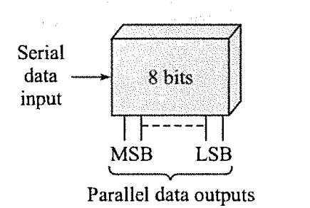
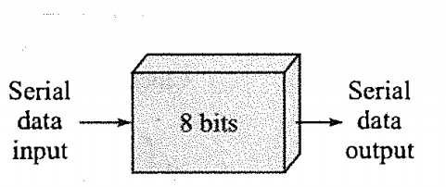
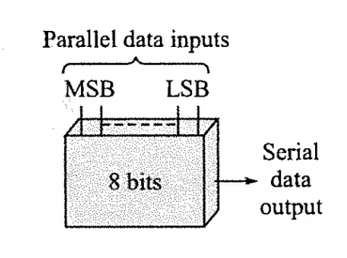
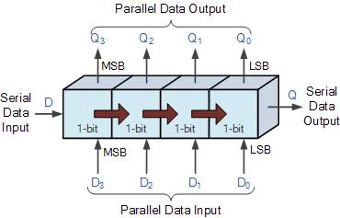
Types of Shift Registers
SERIAL IN SERIAL OUT
PARALLEL IN PARALLEL OUT
SERIAL IN PARALLEL OUT
PARALLEL IN SERIAL OUT
SERIAL IN PARALLEL OUT
UNIVERSAL

Slide 5











Semi-conductor Memories
Larger systems use SC chips which are made of an array of memory cells.
Made of flip-flops which are Bipolar, MOS, CMOS.
Two types:
RAM
ROM
Can be used to store programmed instructions and data.

Slide 6

RAM
R0M
Volatile
Temporary storage of programs
Types:
SRAM
DRAM
Not volatile
Used to store data that is not to change e.g startup programs
Types:
Mask Programmed RO
PROM
EPROM
EEPROM

Slide 7



Memory in Arduino
FLASH MEMORY
SRAM
EEPROM
Stores arduino sketch; program image and any initialized data.
ATMega 128-32k
ATMega 2560-256k
Where sketch creates and manipulates variables.
Is made of 3 parts: static data, heap, stack.
Where you can store long-term data.
ATMega 128-1k
ATMega 2560-4k
ATMega 128-2k
ATMega 2560-8k

Slide 8




Laurine Owino (Lamoy)
Electrical and Electronics Engineering Student, 5th year.
Cyber-security and hardware/firmware enthusiast

